Slide 1


All Presenters:
Please do not delete any slides
Follow instructions on slide 2 and 3 to create your lightning talks slides
GSoC 2025
Mentor Lightning Talks
October 24th, 2025

Slide 2
Speaker Order - Friday 9:30-10:30AM
Order | Mentor Name(s)
1 | Sanju Tiwari
2 | Cyrille Artho
3 | Ankit Mahato
4 | Ayush Billore
5 | Stefano Garzarella
6 | Ashish Yadav
7 | Shivay Lamba
8 | Shubham Jain
9 | Bawantha Thilan
Order | Mentor Name(s)
10 | Rudra Chopra
11 | Diya Solanki
12 | M Viswanath Sai
13 | Vedant Singh
14 | Ege Korkan
15 | Jaideep Prasad
16 | Anastasia Hernandez- Koutoucheva
17 | Vissarion Fysikopoulos
18 | Andreas Dräger, NRNB
19 | Vedant Jain Confi
dential and Proprietary

Slide 3





Sanju Tiwari (Mentor)
DBpedia Association
The DBpedia Association was founded in 2014 to support DBpedia and the DBpedia Community. The DBpedia Association is currently situated in Leipzig, Germany and affiliated with the non-profit organisation Institute for Applied Informatics (InfAI)
DBpedia is a large community driven project that aims to extract structured information from wikipedia and make it available on the web as Linked Data
It takes the semi-structured data from the wikipedia infoboxes and cpnvert into a Knowledge-Graph by using RDF.
DBpedia

Slide 4



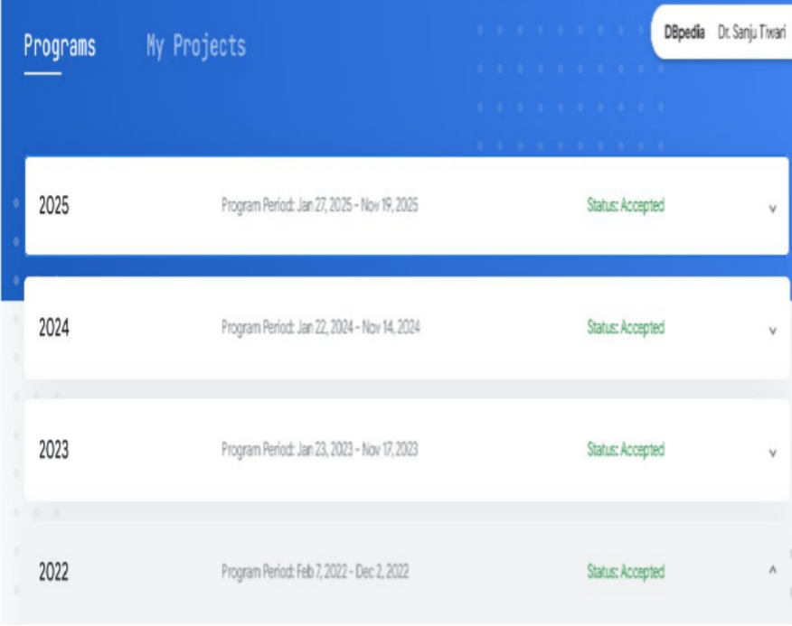
Sanju Tiwari, DBpedia Association
GSoC 2022: Template Discovery for Neural Question Answering over DBpedia https://sauravjoshi23.github.io/GSoC- Neural-QA-Model-DBpedia/
GSoC 2023: Question-Answering over DBpedia with Pretrained Auto-regressive Models https://mehrzadshm.github.io/GSoC-2023- blog/
GSoC 2024: Building the Foundational Architecture of Hindi DBpedia Chapter https://deba-iitbh.github.io/deba-gsoc24/ GSoC 2025: Evals and Enhancements https://advenk.github.io/av-blog/
DBpedia

Slide 5
Work during 2024-25 as a leading mentor of Hindi DBpedia Chapter
GSoC 2024 laid the groundwork by developing a Neural Hindi Wiki Triple Extraction pipeline.
The project combined mapping-based extraction (infobox mappings) with neural extractors to produce subject–predicate–object triples from Hindi text, linking them to DBpedia ontology and entities.
Tokenization and POS tagging (using Stanza), NER tagging (using IndicNER), rule-based mention detection, coreference resolution (using a multilingual model TransMuCoRes), relation extraction (using models like mBERT-based REBEL, IndIE, and an LLM (Mistral)), and entity linking (using mGENRE for Wikidata/DBpedia linking).
DBpedia
GSoC 2025 aimed to enhance the existing pipeline by first evaluating and then improving it.
Based on 2024, evaluated different prompt strategies like zero-shot, few-shot, chain-of-thought etc with small language models like gemma, llama, mistral for the task of multilingual information extraction. gemma works best for multilingual IE using the ReAct framework.
the SPARQL endpoint for the Hindi chapter was dockerized and benchmarked on a temporary server

Slide 6
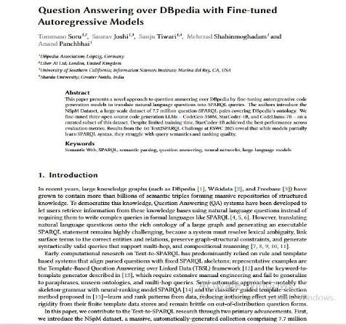
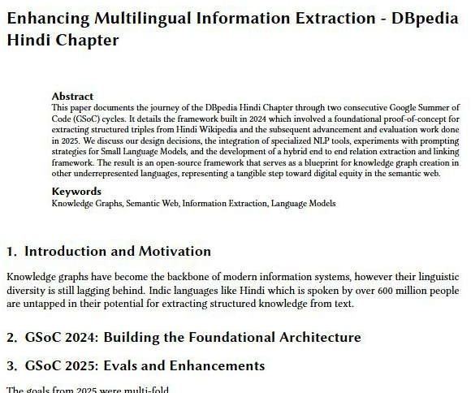
Research Findings
In Publication
In Progress

Slide 7
Cyrille Artho
The JPF Team

Slide 8
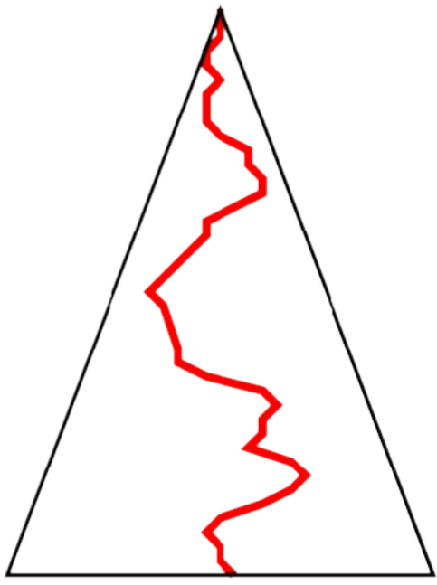

Beyond Testing
Testing Model Checking

Slide 9
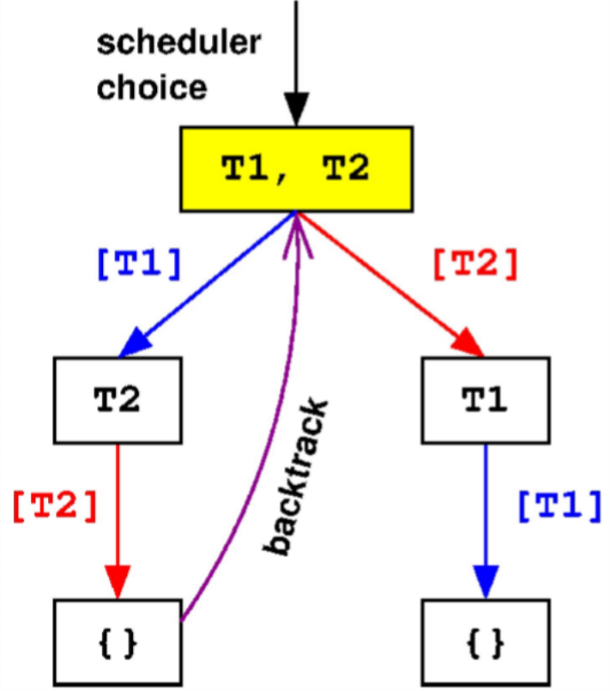
Software Model Checking
Backtrack execution to explore all choices.
Keep copy of visited states.
Limitations:
Memory, native code.

Slide 10
Mahmoud's work in GSoC 2025
 | System under test and libraries
JPF (jpf-core) | Model classes | Extensions
 | Model Java interface (MJI)
 | JPF VM
 | Native peer classes
Host JVM
Update JPF and extensions to support OpenJDK 11 and 17

Slide 11
Ankit Mahato
API Dash

Slide 12
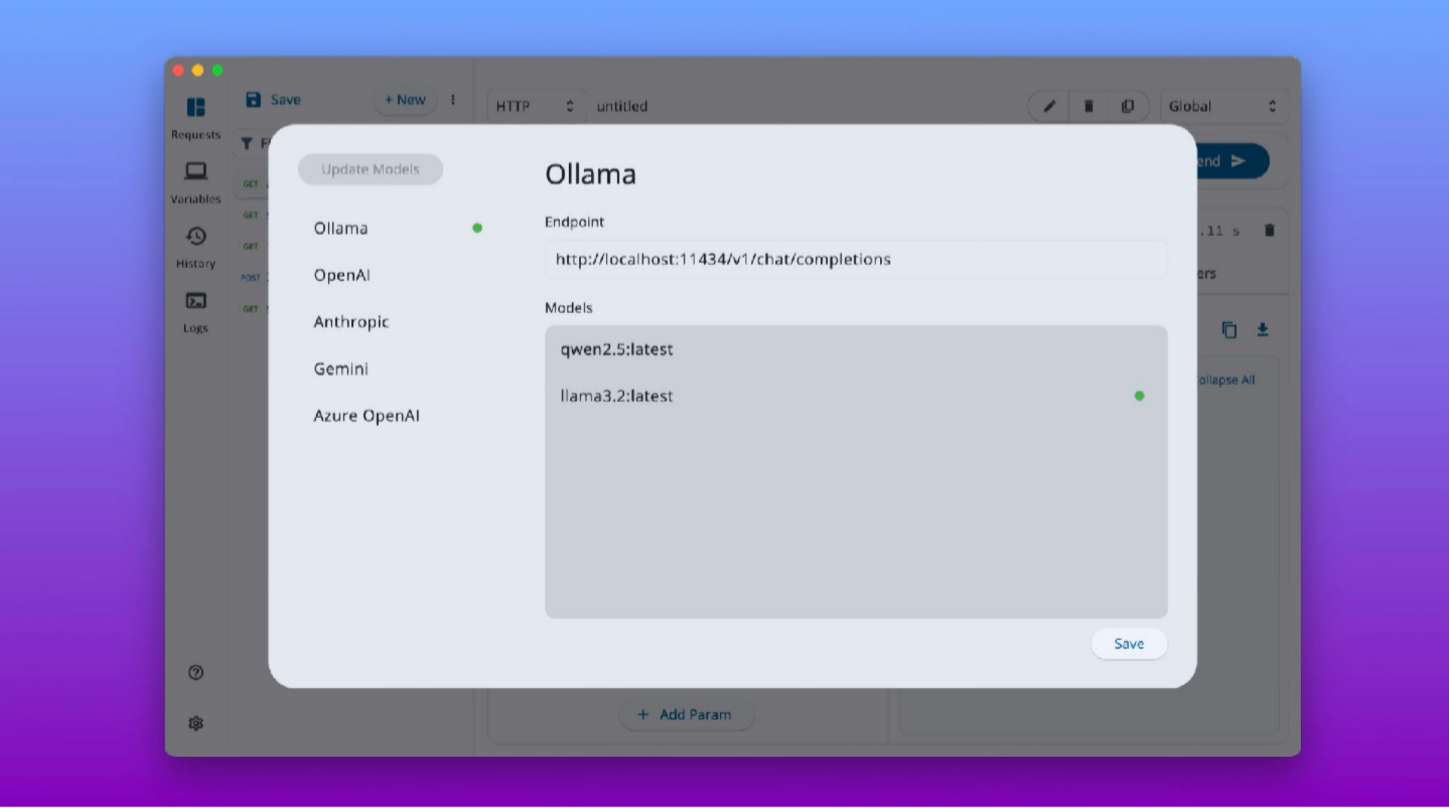

Slide 13
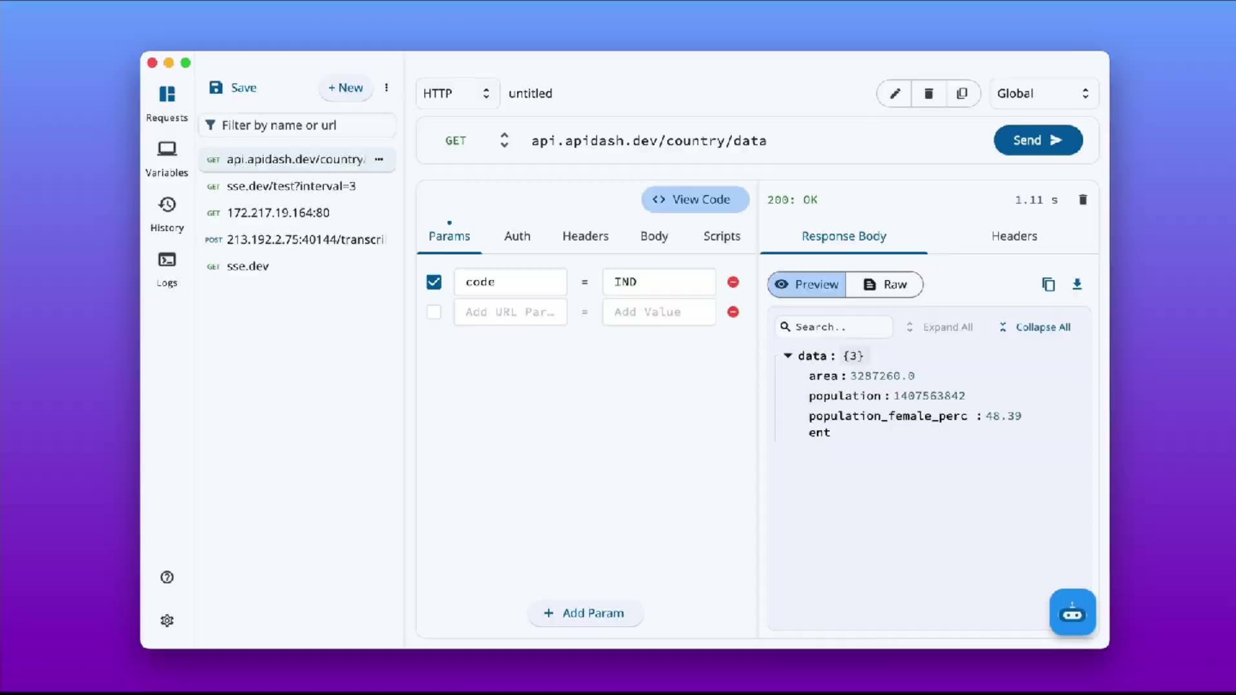

Slide 14
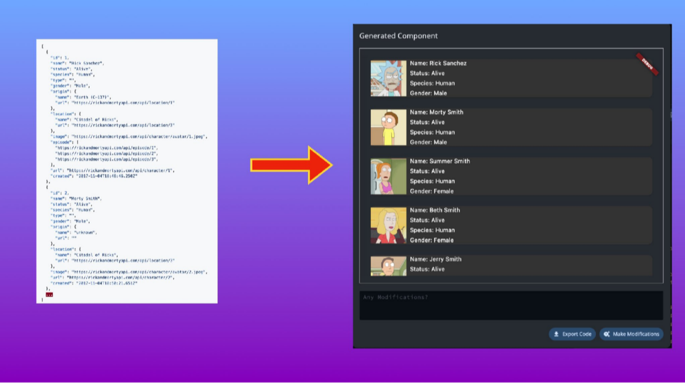

Slide 15
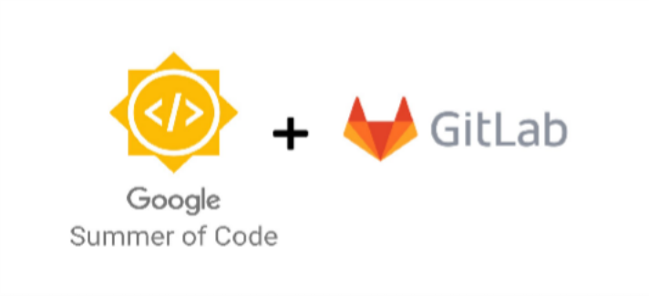
Ayush Billore

Slide 16

AI made proposals efficient — and identical.

Slide 17
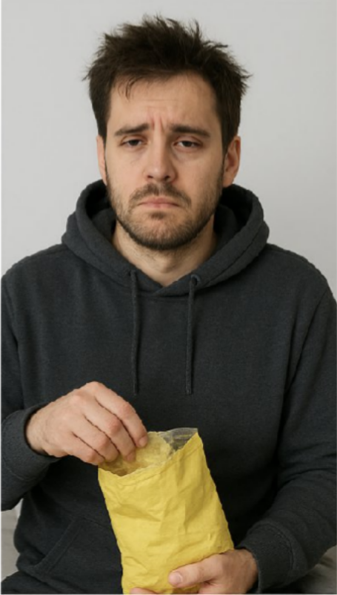

First Impression != Last Impression

Slide 18


Slide 19


Stefano
QGEMUa(& rurstz-vmma)
rella

Slide 20
Ashish Yadav
AnkiDroid

Slide 21


Review Reminders | Contributor: Eric
What: The Goal
To design and build a completely new, reliable, and feature- rich review reminder system to replace AnkiDroid's old, non- functional one.
Why: The Problem
The existing notification system had been completely broken for over 5 years, leading to it being one of the most common and persistent user complaints on the Google Play Store.
How: Key Achievements
A new, comprehensive reminder system was built from scratch, featuring reliable, customizable (global/deck-specific) notifications, advanced filters, and a clean UI.

Slide 22
AnkiDroid Tablet & Chromebook UI | Contributor: Hari Srinivasan
Why: The Problem
The existing AnkiDroid interface was designed for phones, resulting in poor usability, wasted space, and a lack of desktop-standard features (like mouse controls) on large screens.
How: Key Achievements
The project introduced resizable dual-pane layouts, enhanced mouse support (like right-click), and a live note previewer to create a desktop-like experience.

Slide 23
Shivay Lamba
Kubeflow

Slide 24
Project 11: Support Postgres for Kubeflow Pipelines backend
Goal - Implement support for PostgreSQL as an alternative to MySQL/MariaDB in Kubeflow Pipelines (kubeflow/pipelines#9813)
Kubeflow Pipelines must store information about pipelines, experiments, runs, and artifacts in a database. Currently, the only database it supports is MySQL/MariaDB.
We plan to support PostgreSQL as an alternative to MySQL/MariaDB so users will be able to reuse existing databases, and PostgreSQL will be a good use case for supporting multiple databases.
Mentee - Yunkai

Slide 25
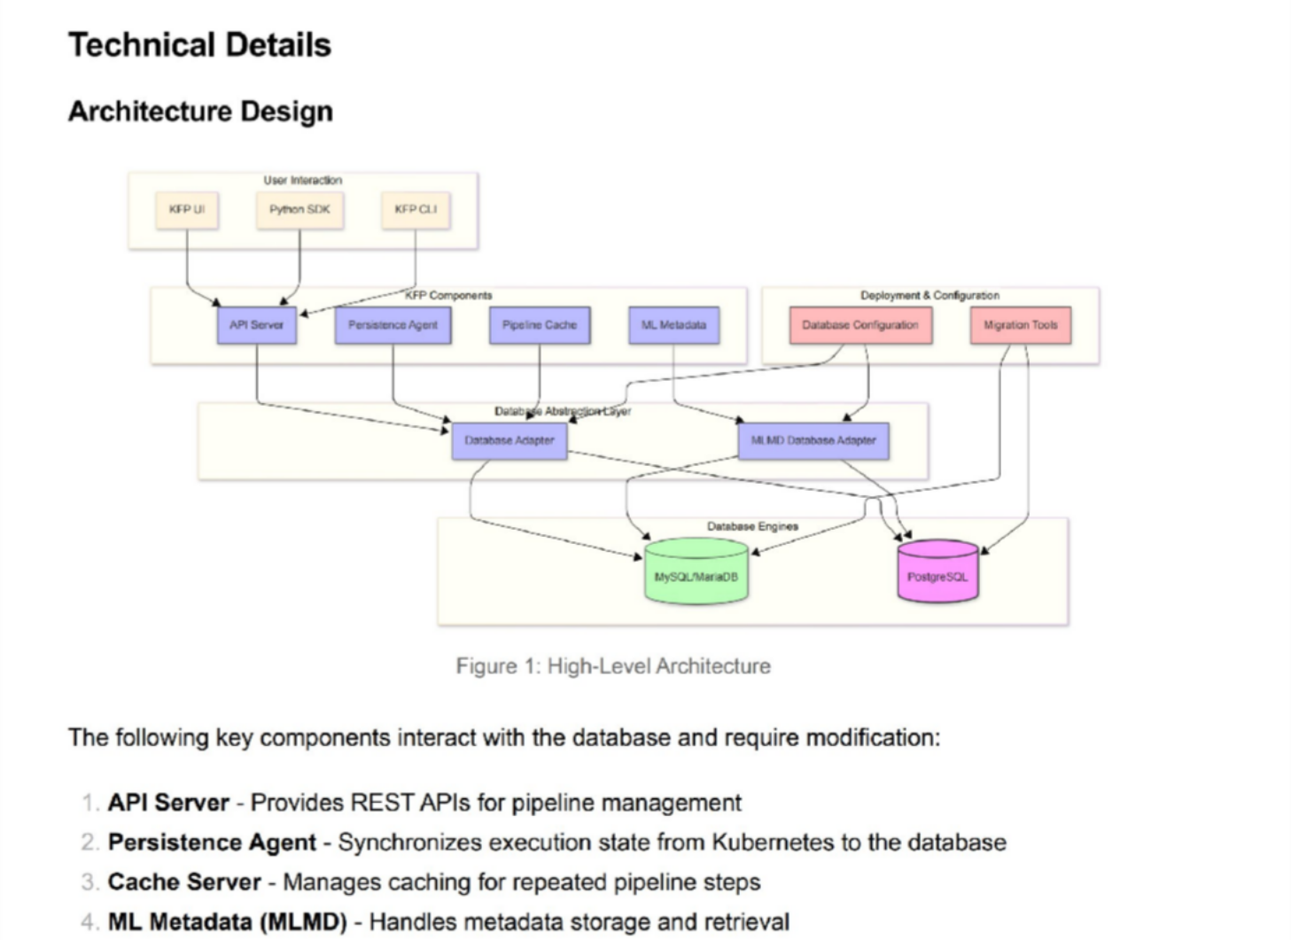
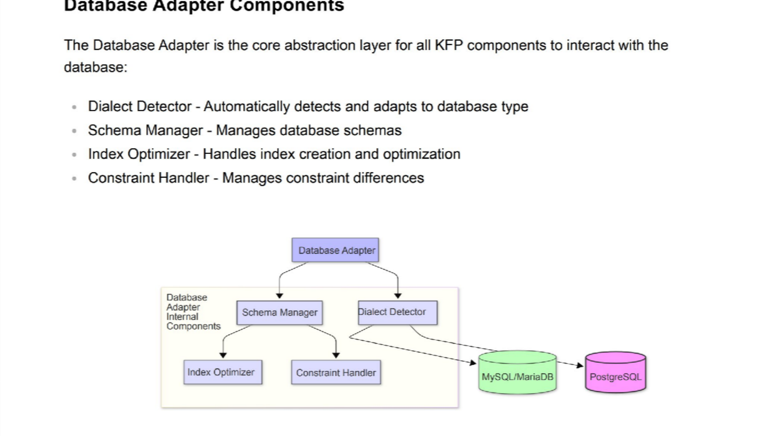

Slide 26
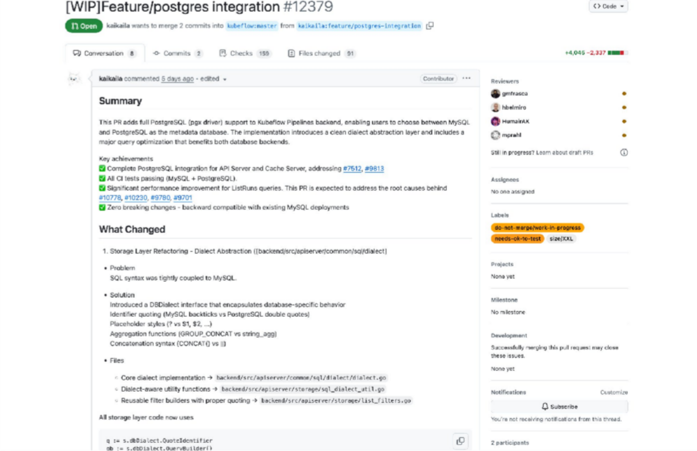

Slide 27
Shubham Jain
Keploy

Slide 28
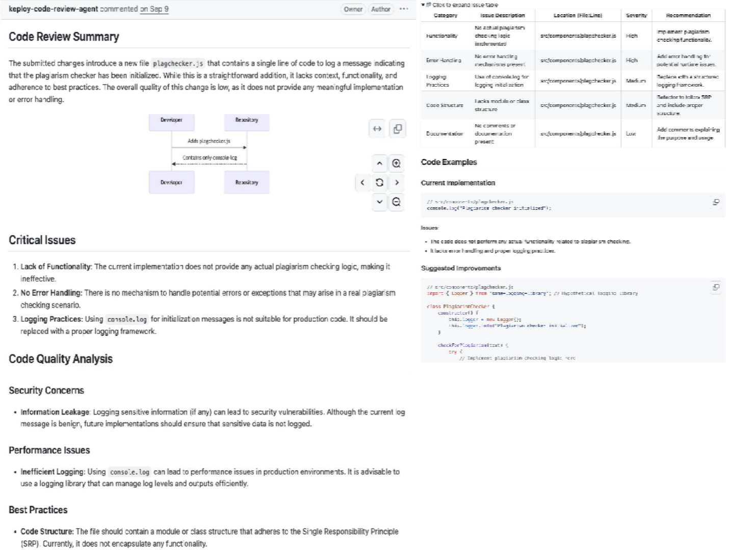

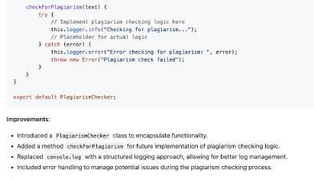
Code Review Agent
Generate code reviews for PRs with open source models
like Gemma 3
Can be run fully air-gapped
OOTB supports github.
Contributor: Gaurav

Slide 29
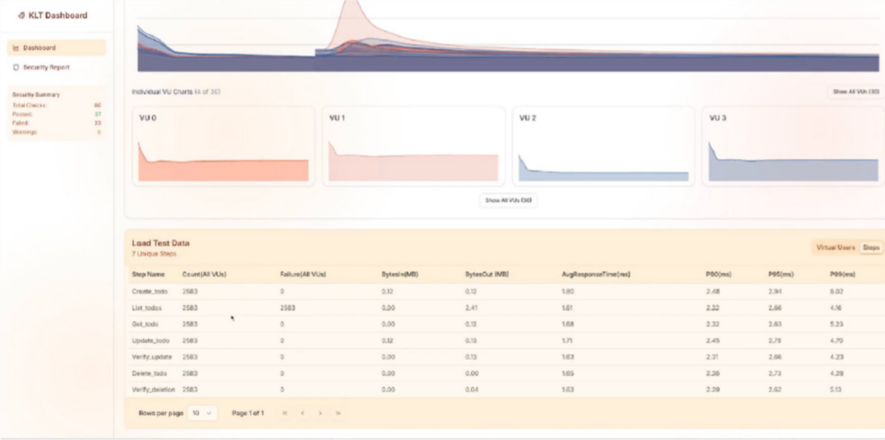

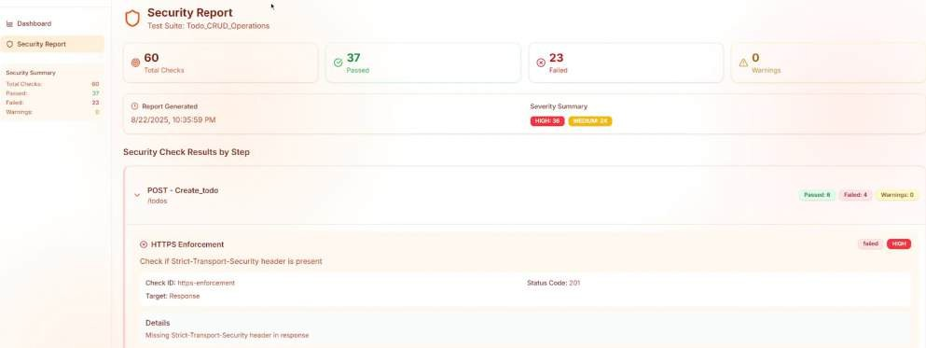
Performance and Security Testing
Simple and automatic:
Performance tests for APIs
Request count and failure rates
Response time percentiles (P90, P95, P99)
Throughput (requests per second)
Data transfer (bytes sent/received)
Virtual user count over time
Common security vulnerabilities analysis of APs
Vulnerability count by severity
Check pass/fail status
Custom rule evaluation results
Allowlist filtering statistics
Contributor: Ahmed Mamdouh

Slide 30
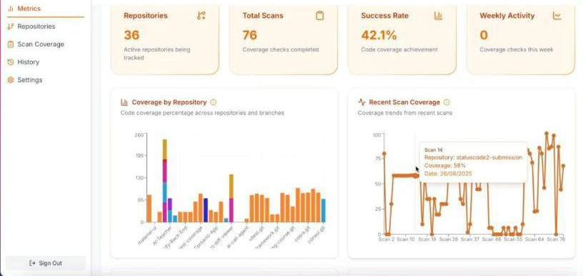

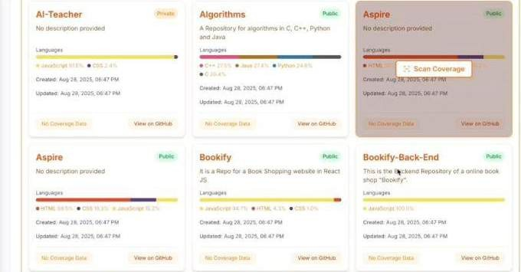
Dashboard for Modular Metrics
Visualization
Centralized dashboard to view quality metrics across repos like test code coverage
Contributor: Swapnendu Banerjee
API Contract Testing
automatically generate client side contract tests for playwright tests
Implement server side contract testing
Contributor: Harsh Vashishtha
Code Indexer for Efficient Retrieval
GraphRAG system integrated including codebase indexing, dynamic index updates, hybrid context retrieval
Contributor: Sparshh

Slide 31
Bawantha Thilan
OpenMRS - Performance Testing Enhancement Project

Slide 32

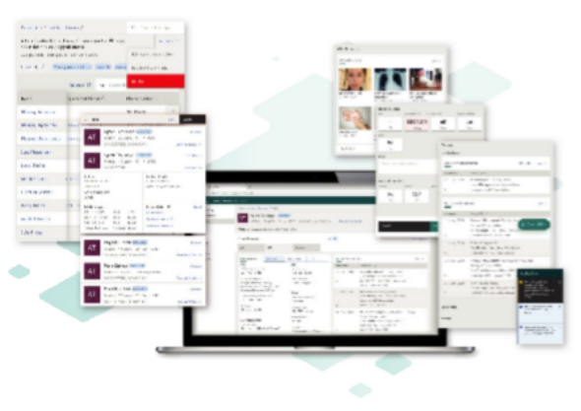
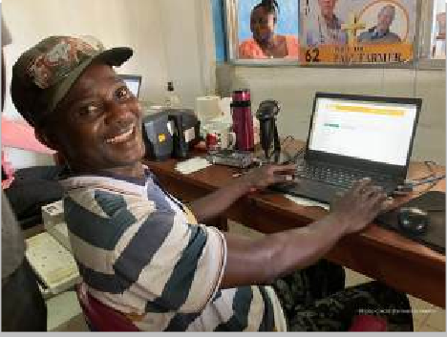
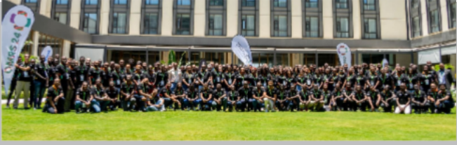
In 10 seconds… What is OpenMRS?
Open source Medical Record System
For low-resource
settings
Maintained by a global community

Slide 33
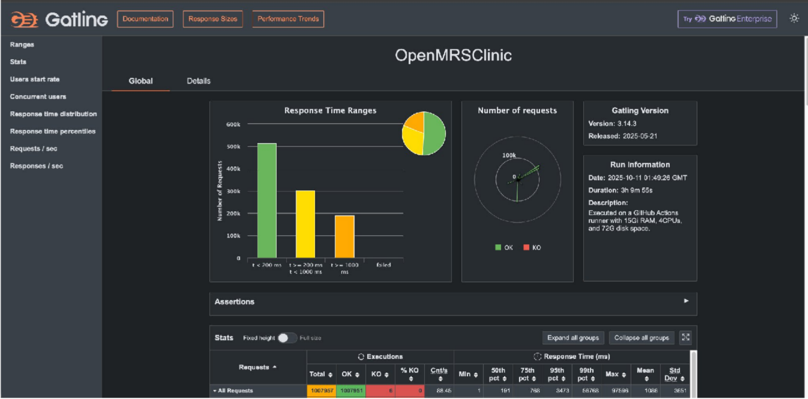

Slide 34
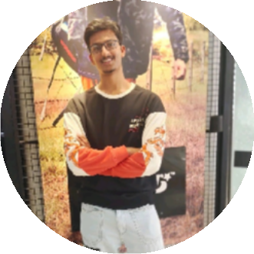
How It Helped Developers
Data driven debugging. no guessing.
Saves time
Builds confidence
Ganesh Devisetti

Slide 35
Rudra Chopra
Eclipse Foundation SW360

Slide 36
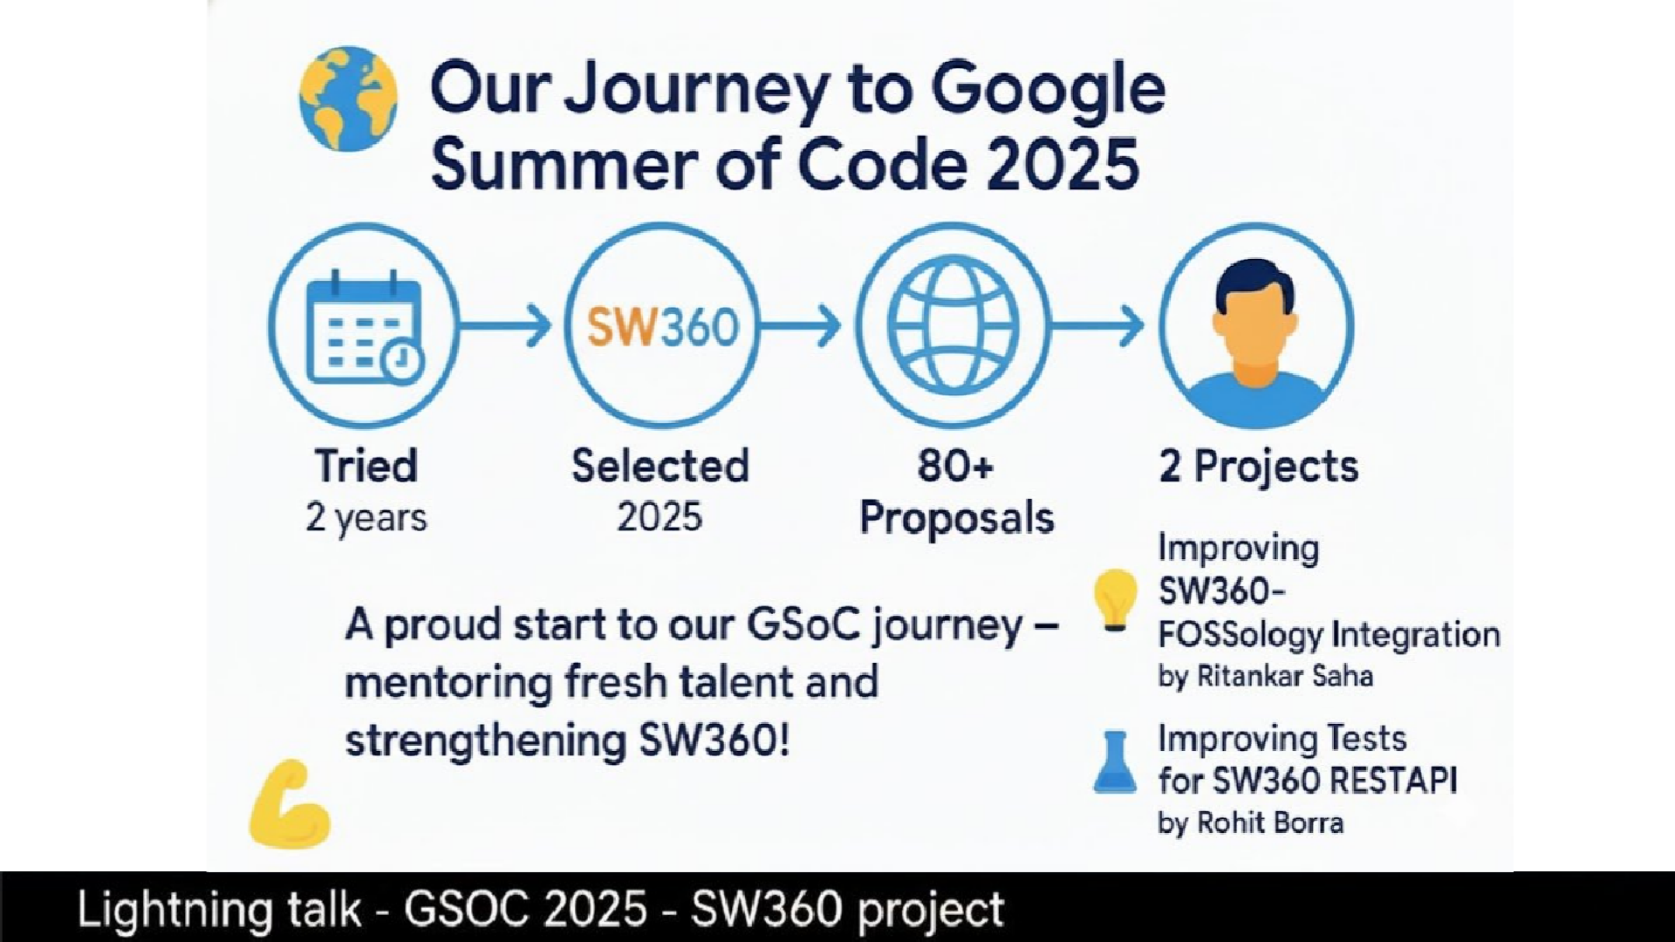

Slide 37
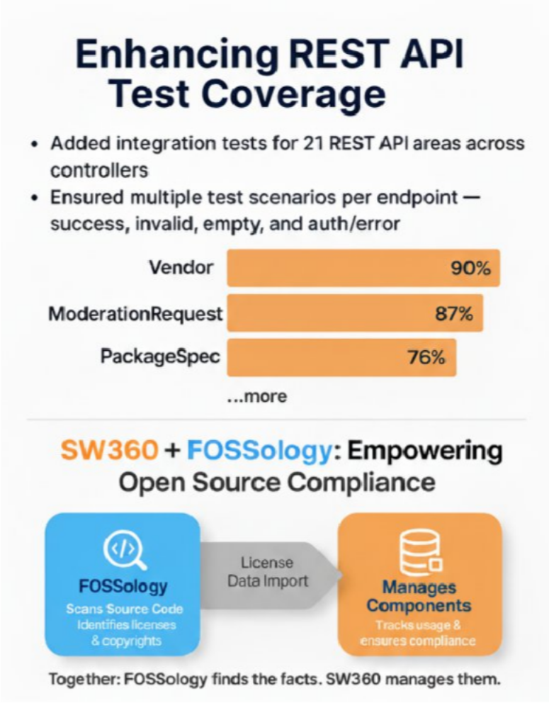

Slide 38
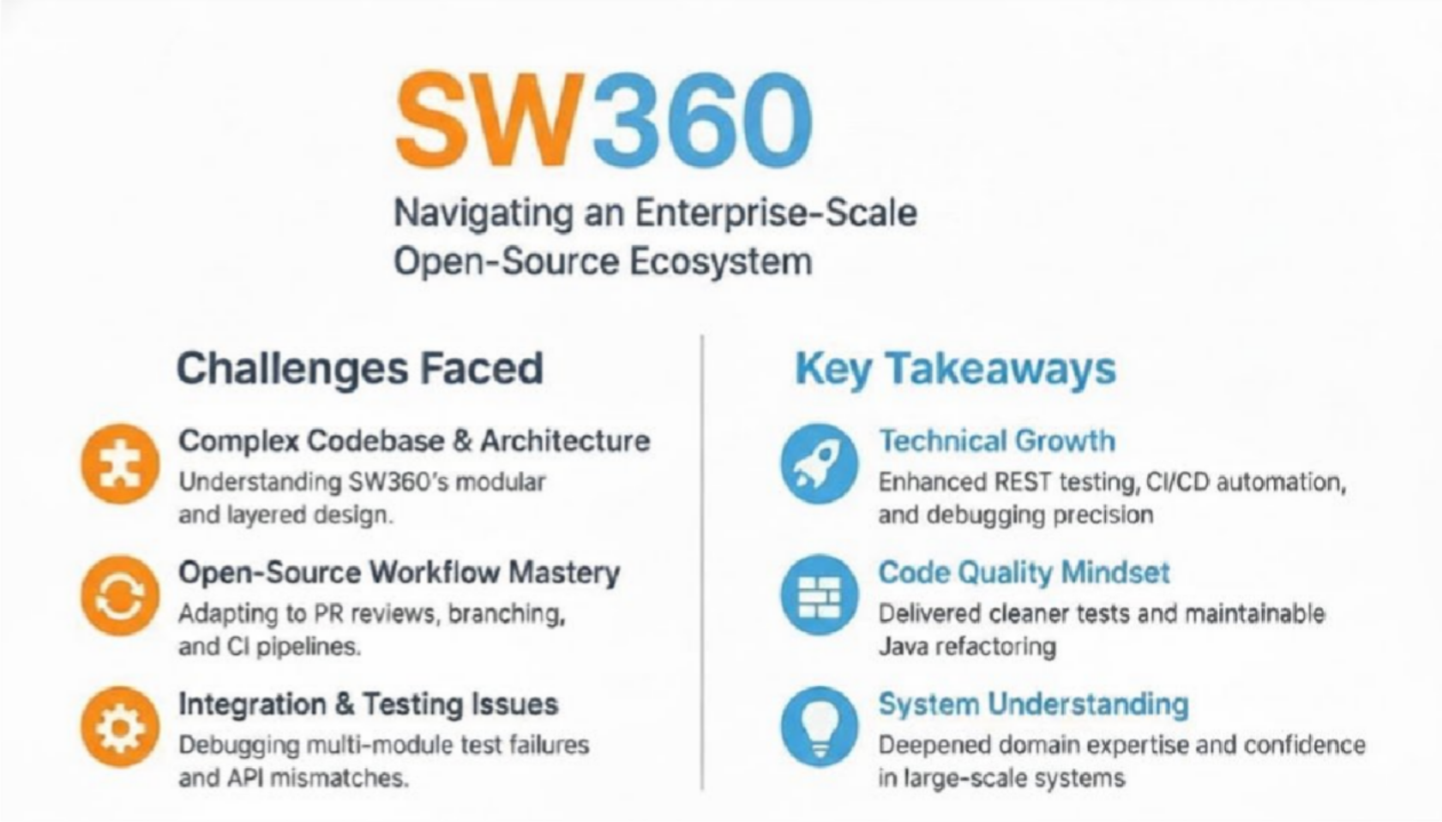

Slide 39
Diya Solanki
Processing Foundation

Slide 40




Processing Foundation
Our 13th year participating in GSoC!
>110 Projects since 2011
Organization Mission:
Our mission is to promote software learning within the arts, artistic learning within technology- related fields, and to celebrate the diverse communities that make these fields vibrant, liberatory, and innovative. Our goal is to support people of all backgrounds in learning how to program and make creative work with code, especially those who might not otherwise have access to tools and resources.
Project Contributor: Kamakshi Bali (mentored by Diya Solanki & Tristan Espinoza) Enhance the developer and coding experience by adding IntelliSense features similar to those found in professional, multi-language IDEs, while continuing to support Processing’s mission of making coding accessible to everyone. https://p5js.org/contribute/access/

Slide 41
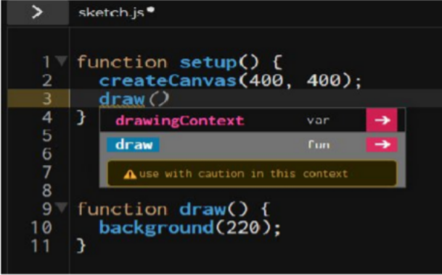
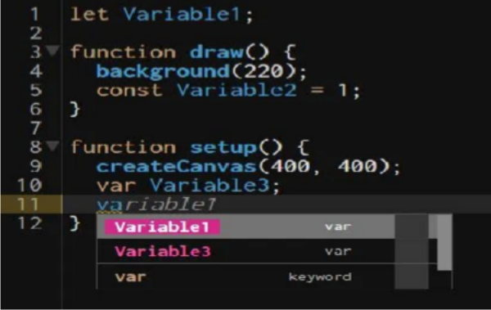
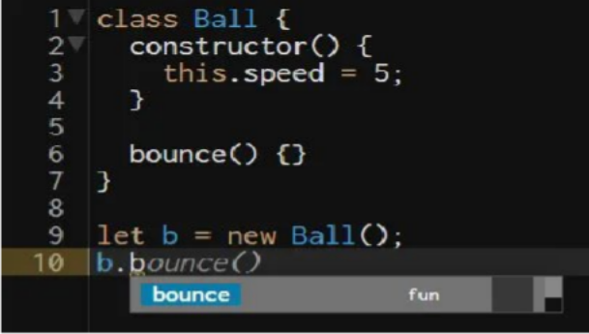
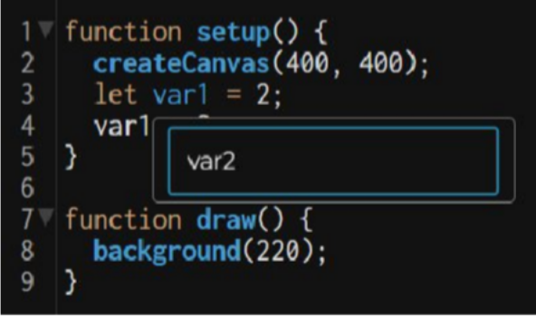
Intellisense & User-Friendly Features in the p5.js Editor
Accessibility Improvements:
ARIA roles announce in Context-Aware renaming.
Jump to Definition: Announced when a jump occurs.
All actions can be triggered via keyboard shortcuts.
1. Context-Aware Autocomplete
3. Context-Aware Renaming
2. User-Defined Code Suggestions
4. Jump to Definition

Slide 42

All 3 PF GSoC 2025 projects will also be presented at the Open Assembly 2025.
Date: Wednesday, October 29, 2025 | Time: 1:00 - 3:30pm EST | Format: Free, Virtual
https://openassembly.processingfoundation.org/

Slide 43
M Viswanath Sai
Prometheus Operator

Slide 44
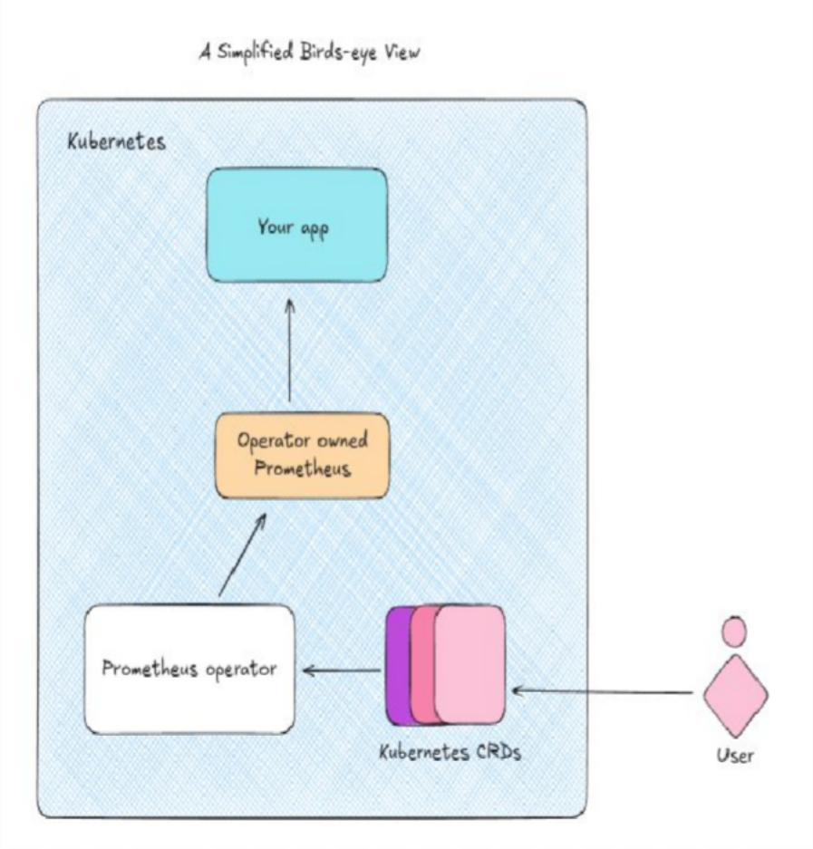



Kubernetes
Prometheus
Declarative workload
management
Collect metrics with granular
control
Define desired state, let K8s
handle the rest
Not confined to Kubernetes
deployments
Prometheus Operator
Deploy and manage Prometheus the Kubernetes way Declarative configs for powerful monitoring automation within Kubernetes

Slide 45
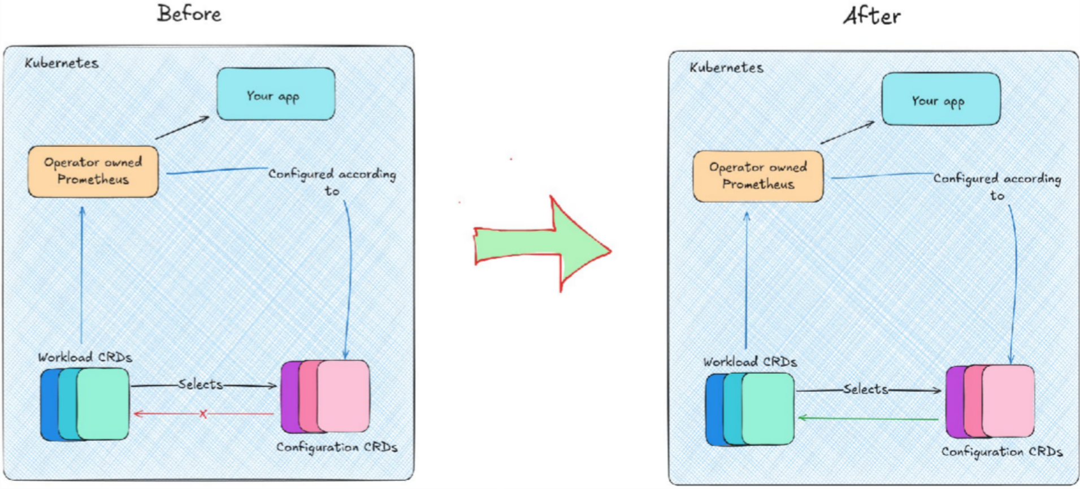
Status Subresource For Configuration Resources

Slide 46
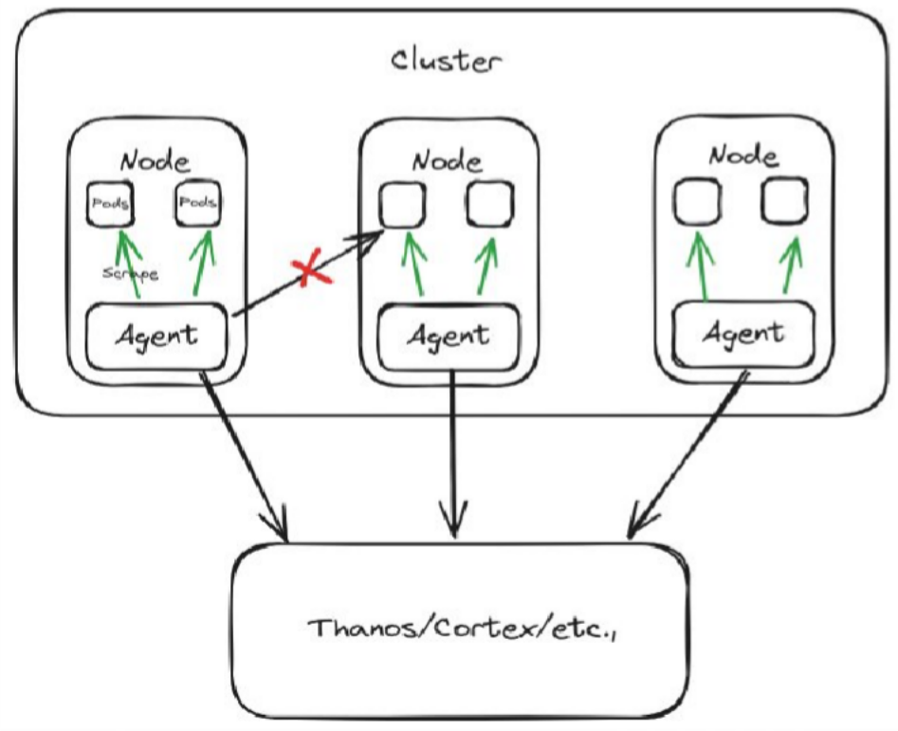
Prometheus Agent Daemonset Mode
Allows Automatic scaling
Suitable for very large clusters Failure is node-wide

Slide 47
Vedant Singh
Liquid Galaxy Project

Slide 48


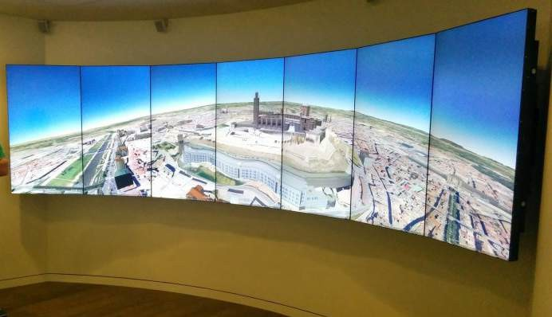
What is Liquid Galaxy?
Liquid Galaxy is a remarkable panoramic system that is tremendously compelling.
It started off as a Google 20% project created by Google engineer Jason Holt to run Google Earth across a cluster of PC's and it has grown from there!
The Liquid Galaxy Project works on extending the Liquid Galaxy system with open source software both improving its administration and enabling open source applications, so that content of various types can be displayed in the immersive panoramic environment.

Slide 49
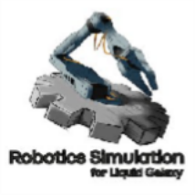




Robotics Simulation For Liquid Galaxy
GSoC 2025 Project by Debanjan Naskar
Imagine you're holding your phone and using it as a remote control for robots. But instead of watching on a tiny phone screen, you're standing in front of multiple large displays that show a panoramic, immersive view of what the robot sees and does.
In simple terms, this project lets someone control virtual robots from their phone and watch them on the Liquid Galaxy Rig.

Slide 50
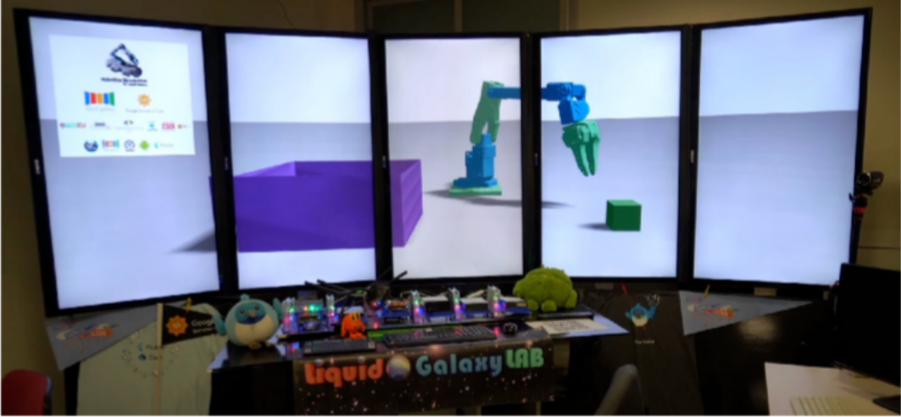
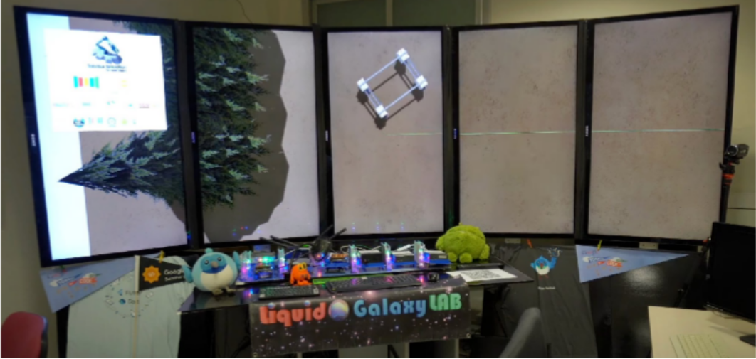
SO Arm 100 - An open source robotic arm which can also perform demo action in the simulation.
Amigabot Farm-ng - A movable platform to serve as a powerful agricultural robot.

Slide 51
Ege Korkan
Eclipse Foundation - Thingweb Project

Slide 52
UI Components for IoT Developers
https://github.com/eclipse-thingweb/ui-wot
Tried to cover multiple aspects at once
Interaction semantics
Protocols
Data structures
Works with any UI framework
Leverages Thing Description standard: w3.org/wot

Slide 53
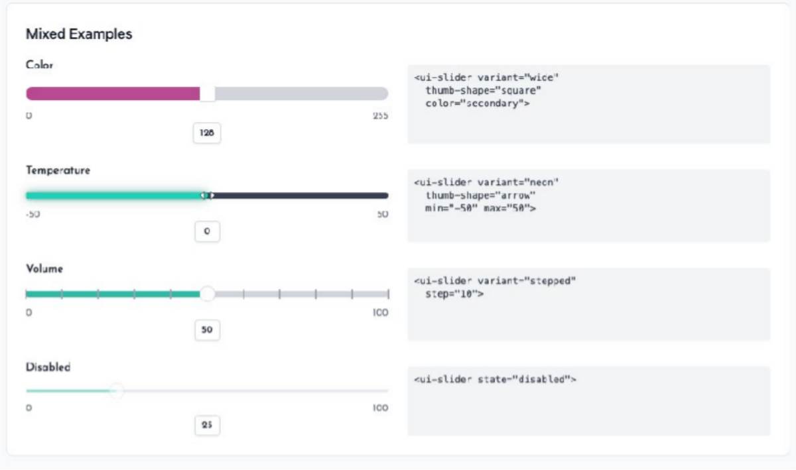
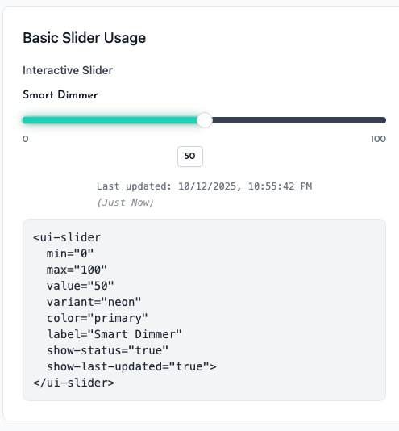
UI-WoT Components

Slide 54
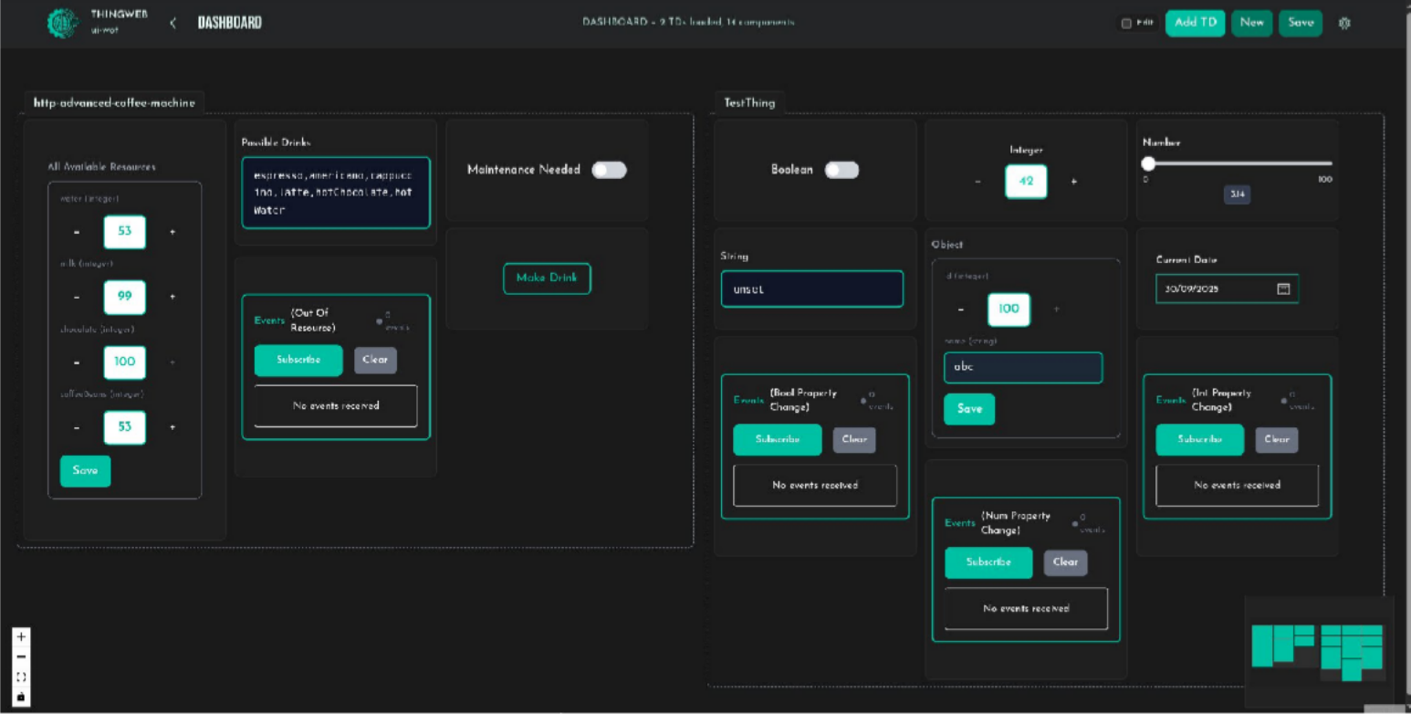
UI-WoT Generator

Slide 55

Jaideep Prasad
AOSSIE

Slide 56










What we do

Slide 57
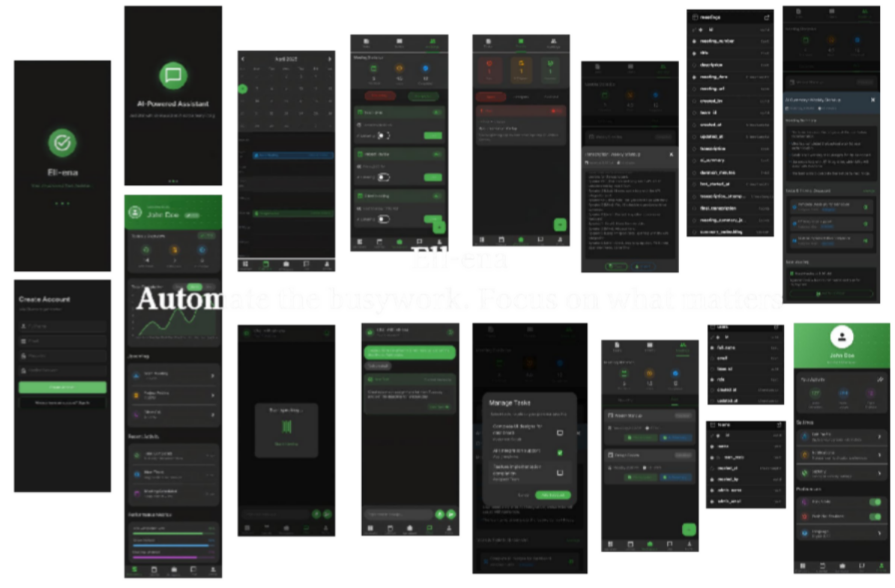
Ell-ena : your AI Product Manager

Slide 58
Ell-ena : your AI Product Manager
Automated Task Management: Your daily scrum assistant
Context Capture: Video meetings / project notes
Workflow automation: Anticipates needs and priorities

Slide 59
Anastasia Hernandez- Koutoucheva
Wellcome Sanger Institute

Slide 60
Vissarion Fysikopoulos
GeomScale

Slide 61
Shake and Bake - Sampling from the boundary of convex polytopes
Contributor: Iva Janković (currently PhD student @ Edinburgh)
Goal: Implement Markov Chain Monte Carlo-based Shake and Bake algorithm for uniform sampling from the boundary of a convex polytope
Motivation: Fundamental problem in computational geometry & statistics + applications in metabolic network analysis
Results: Implementations of new and classic algorithms in C++ with R and python interfaces

Slide 62
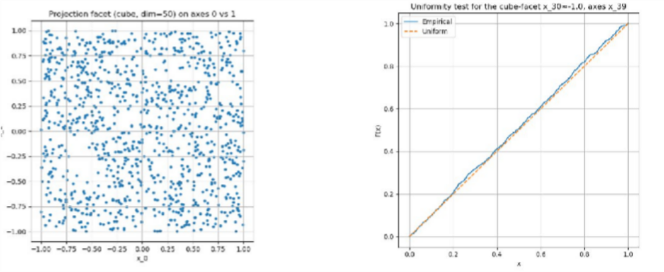
Challenges I
Implement the basic version of 80’s algorithm
Much faster than existing implementations (shakeandbake R package)
Challenges: evaluate the quality of samples
Solution: implement a statistical test for each facet of the polytope

Slide 63
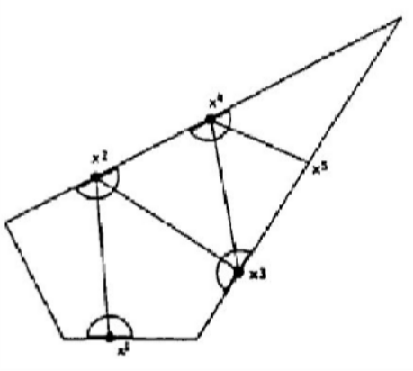
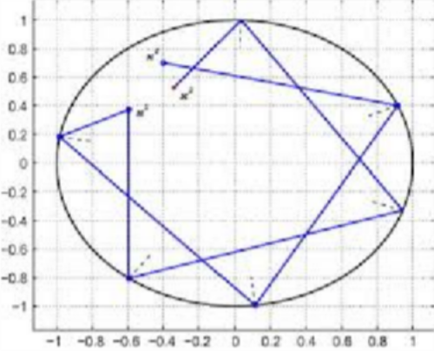
Challenges II
Implement a new hybrid algorithm: billiard shake and bake
Preliminary results show that it is much faster than the original one
+

Slide 64

Andreas Dräger
NRNB – the National Resource for Network Biology

Slide 65
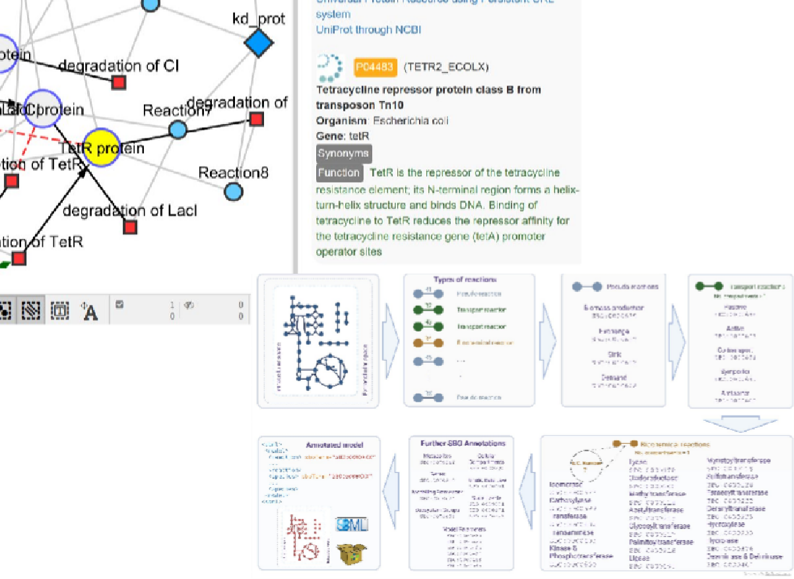
Computational Models & Simulation of Biological Systems
Google Summer of Code projects in 2025
Better graphical editing of biological networks with Java™
An update to the network editor
CySBML: Smarter, Simpler, Automated
SBO-
annotator ⬇
Better semantics in Biomodels with
SBOannotator (Python):
Coverage: Across 108 models,
3,317 reactions were upgraded from generic SBO:0000176 to more specific terms.
Efficiency: Mean processing time
432.99 s/model.
Specificity: Multi-database integration notably improves annotation specificity.
⬆New Graphical User Interface of CySBML within Cytoscape
Better simulation with Java™
A general linear optimization
A new ordinary differential equation solver

Slide 66
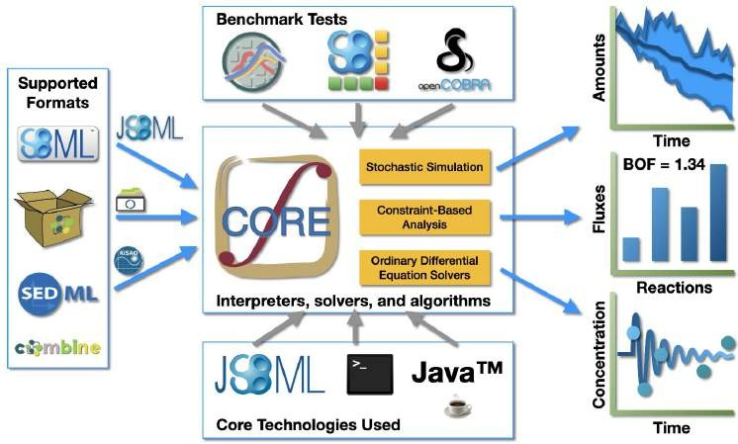


Dynamic and Steady-State Models of Metabolism
New algorithm LSODA
Numerical solver for ordinary differential equations
Separate project OptSolvX
abstraction layer between linear solvers and optimization problem
runs FBA on x86 & ARM
choose best suited backend (e.g., CPLEX, Gurobi, Apache)
SBSCL
OptSolvX
The Simulation Core Library (SBSCL) reads Biomodels in SBML format and performs various simulations

Slide 67
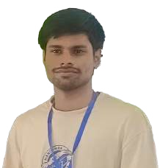
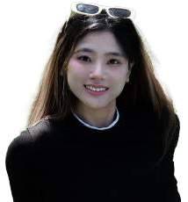
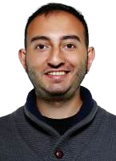







Our International Team at NRNB
Our Students
Hikmet Emre Kaya
🇿🇦🇹🇷
The Mentors
Michael Gaas
🇩🇪
Arthur Neumann
🇧🇷🇩🇪
Ayush Baranwal
🇮🇳
Jiahui Hu Neu
🇨🇳🇺🇸
Taichi Araki 🇯🇵 coding
Prof. Akira Funahashi
🇯🇵
Dr. Matthias König
🇩🇪
Dr. Nantia Leonidou
🇬🇷🇩🇪
Prof. Andreas Dräger
🇩🇪
with Arthur in Stuttgart

Slide 68
STOP
STOP!
The reset of the slides are for later!

Slide 69
Speaker Order - Friday 4:00-5:00PM
Order | Mentor Name(s)
1 | Antonio Jimenez
2 | Marc Gonzalez
3 | Victor Cuadrado
4 | Nikhil Agarwal
5 | Zeeshan Rafique
6 | Turan Furkan TOPAK
7 | Kannupriya Kalra
8 | Atharva Arya
9 | Mohit P. Tahiliani
10 | Peter Dudfield
Order | Mentor Name(s)
11 | Dmitriy Pastushenkov
12 | David Pascual
13 | Lorena Goldoni
14 | Felipe Borges
15 | Till Kamppeter
16 | Christoph Badura
17 | Renan Matsuda
18 | Sreeja Kamishetty
19 | Yuriko Kikuchi
Confidential and Proprietary

Slide 70
Waitlist for Lightning Talks
Sarrah Bastawala - Slides added
Oliver Kopp - JabRef e.V. (slides already in) 3.
4.
5.
6.
Confidential and Proprietary

Slide 71
Lightning Talk Slides
This shared deck will be where you save your completed slides.
To keep to Google’s brand guidelines, a few reminders when creating slides:
Please use a white background
No other company logos (example: twitter logo), memes or pictures of people may be used unless you have explicit permission to use them
Use the template for your title slide and then add up to 3 additional slides
Your presentation should be about the GSoC projects this year for your org, not about what your org does. You can spend maybe 15 seconds briefly discussing what your org does for context but the focus should be on the GSoC 2025 projects.
Slides are due no later than October 22nd

Slide 72
Antonio Jimenez
Typelevel

Slide 73

Cats Effect: multi-threaded I/O runtime

Slide 74


Slide 75


Slide 76
Marc Gonzalez
Uramaki LAB

Slide 77

Uramaki LAB
 |  |  |  |  |  |  | 1st GSoC 3 internships 200 users |  | 2nd GSoC 5 internships 430 users
2020 Beginning 3 countries |  | 2021 10 collaborators 5 countries |  | 2022-2023 50 users 2 publications
2020 | 2021 |  | 2022 |  | 2023 | 2024 |  | 2025
960
Commits!
1759 Commits!
⭐Stars: 174
🔗Forks: 306
👥Contributors: 111
🔀PR: 419
📈Issues: 602
📣Commits: 6568

Slide 78


Slide 79


Slide 80
Victor Cuadrado
Kubewarden (CNCF)

Slide 81

CNCF Sandbox project
K8s Policy Engine, production ready
Policy As Code: Wasm shipped as OCI artifacts
OCI registry
policy-server
K8s controller
kwctl CLI utility
Language SDKs

Slide 82

Typescript/Javascript SDK by Esosa Ohangbon
https://github.com/kubewarden/policy-sdk-js
📅, 💬
K8s
Wasm with Javy
Wasm Host/Guest APIs in JSON
📃
🎉🎊🎈🎉🎉🎈🎈🎊□🙌

Slide 83
Nikhil Agarwal
Oppia Foundation

Slide 84

Oppia Foundation

Slide 85
Acceptance Tests
Cover all Critical User Journeys using acceptance testing.
Reduce manual testing.
Remove flakiness from the current test suites.
Complete migration from E2E tests to Acceptance tests.

Slide 86
Zeeshan Rafique
Mircroelectronic Research Lab (MERL)

Slide 87

About MERL
MERL is a research lab at Usman Institute of Technology University (UITU) in Karachi, Pakistan.
The lab focuses on microelectronics using the open-source RISC-V architecture, bridging hardware and software to give undergrad students hands-on chip design and “tape-out” experience.
MERL has participated in Google Summer of Code for the past four consecutive years.
GitHub: https://github.com/merledu

Slide 88

MERL GSoC Projects 2025
This year, MERL got five slots.
Integrating TCAM IP into Chipyard via MMIO and RoCC Interfaces
Automated UVM Tuning Orchestrated Via AI Reasoning
AEGIS - AI-Enhanced Generation of Intelligent Scenarios
Running Secure and Vectorized Applications on SoC-Now
Generic Test Bench for RISC-V CPUs Using PyUVM
GSoC Org: https://summerofcode.withgoogle.com/programs/2025/organizations/micro-electronics-research-lab-uitu

Slide 89
My Project: Generic TB for RISC-V Cores
The project is about creating a generic test bench for RISC-V CPUs.
RISC-V is an open source Instruction Set Architecture (ISA).
Written in PyUVM, means no commercial compiler needed.
Easy to integrate with any RISC-V CPU using RVFI interface.
Spike is used as a golden model, which is open source and written in cpp.
Compares the result of each executed instruction with golden model.
Report mismatch immediately (exception / write back data / load store).
Generate execution log for debugging.
GitHub Repo: https://github.com/merledu/coco-rvtb

Slide 90
Turan Furkan
FTreeCOAD
PAK

Slide 91


The Story of 3 Projects
Interactive controls in the 3D View
Multiple files parallel editing
3D PDF Export in FreeCAD

Slide 92


Slide 93


Kannupriya Kalra
Scala Center

Slide 94


Slide 95


The Key Outcome: Traceability Unlocked
Tracing Support (PR #77, #119): Added execution flow tracking, spans, and timing. Integrated Langfuse for developer-friendly traces.
Type-Safe Tracing (PR #165): Rebuilt with sealed traits & composable backends. Ensured reliability and backward compatibility.
Demo & Multi-Backend (PR #184): Built a calculator agent for sequential tool-use. Showcased tracing with Console, Langfuse, and NoOp.
Shubham Vishwakarma
Total PRs Raised | PRs Closed / Merged | PRs Still Open
20 | 18 | 2

Slide 96

How It Works: The Architectural Clarity
LLM4S Tracing Architecture - High-Level Detailed View:
Diagram Flow: Application Layer (Agent Orchestration/Tool Invocation) → Tracing API (StartSpan, EndSpan, TokenUsage, Error) → Tracing Composer → Backends (Langfuse, Console, NoOp)
Tracing Composer functions: Filter & Redaction, Merge & Fan-out, Enrichment, Routing to Backends.

Slide 97


The Foundation for Future AI Systems
Beyond Tracing: The Next Chapter for LLM4S:
Multi-Agent Systems In Progress: DAG-based planner, Pub-sub signals, Scala-native, type-safe orchestration.
A Real Use Case: Meeting Minutes Generator Planned → Full traceability → every step tracked with spans/events.
LLM4S Project Link

Slide 98
Atharva Arya
TARDIS

Slide 99



1994D in galaxy NGC 4526
SN 1054 (1054 AD), Milky Way!
TARDIS is an open-science collaboration that develops python packages to simulate and analyse exploding stars
More technically, it’s a Monte Carlo radiative transfer code that calculates theoretical spectra for supernovae and other transients
36+ GSoC projects completed since 2013 (12 years!)
This year, 2 projects completed!

Slide 100


Haille’s work
Allows researchers to mark which atomic species are responsible for specific spectral features in supernova spectra
line_waves = [3951, 6355, 8567] line_labels = ['Ca II', 'Si II', 'Ca III']
Haille also restructured the formal integral and its source function calculation to improve maintainability.
The restructure also laid the foundation for different code acceleration methods like Jax, for while Haille did initial investigation.

Slide 101


The Regression Data package ensures each TARDIS commit produces exactly the same scientific output.
Riddhi’s code runs the test suite over a series of commits
to find out when which regression data files changed and where.
Riddhi also investigated the TARDIS testing framework carefully and pointed out places where tests could be improved.

Slide 102
Mohit P. Tahiliani
The ns-3 Network Simulator Project

Slide 103

List of Successful Projects (⅘)
Upgrade the AQM Evaluation Suite for ns-3
Mentee: David Lin, Canada
Mentors: Mohit P. Tahiliani, Tom Henderson and Aniket Singh
6LoWPAN Neighbor Discovery Protocol
Mentee: Boh Jie Qi, Singapore
Mentors: Tommaso Pecorella and Adnan Rashid
IPv6 Global Routing
Mentee: Shashwat Patni, India
Mentors: Tommaso Pecorella and Manoj Kumar Rana
NTN Helper and a LEO example for 5G NR
Mentee: Thiago Miyazaki, Brazil
Mentors: Gabriel Ferreira, Biljana Bojovic, Amir Ashtari Gargari, and Katerina Koutlia

Slide 104
Upgrade the AQM Evaluation Suite for ns-3
Student: David Lin, University of Toronto, Canada
Mentors: Mohit P. Tahiliani, Tom Henderson and Aniket Sing.
Project Goal: Upgrade AQM Evaluation Suite for ns-3 to match requirements of RFC 7928
Milestones
Waf to CMake Migration:
Migrated the AQM Evaluation Suite’s build system from Waf to CMake
TCP and ECN Enhancements:
Upgraded the configuration defaults, including replacing TCP BIC with TCP CUBIC
Support newer AQM algorithms:
Added support for new algorithms, such as: COBALT, FQ-PIE
Packaging:
Module packaged and added to the ns-3 app store!

Slide 105



Launched on ns-3 app store! available with ns-allinone-3.45
105

Slide 106
Peter Dudfield
Open Climate Fix

Slide 107


Open Climate Fix
01
» Founded in 2019, in the UK
» Non Profit product lab developing open source AI solutions to decarbonise the electricity grid
» 40 years of AI and energy experience across Google Deep Mind, Siemens Energy, Origin, Kaluza, Nasa and more
Live software: app.quartz.solar
Open Climate Fix
2025

Slide 108

Open Climate Fix
02
» Open Data PVNet
» Cloudcasting UI
» Efficient Cloud-Based Data Streaming for ML: Implementing Ice Chunk + Zarr 3 for PVNet Training
» Improving Probabilistic Solar Forecasts
» Quartz Solar - New data source in ML model
» Adjuster This! TabPFN for Solar Forecast error
Open Climate Fix
2025

Slide 109


Open Climate Fix - Open Data PVNet
Github code
03
» Train ML models to prediction Solar generation on Open Numerical Weather Data
» Data pipeline to make training samples (ocf-data- sampler)
» Used ML models (PVNet)
» Repeatable for open community to build on
Open Climate Fix
2025

Slide 110
Dmitriy Pastushenkov
OpenVINO Toolkit

Slide 111


Slide 112


Slide 113


Slide 114
David Pascual
JdeRobot

Slide 115


JdeRobot open-source robotics software
🧑🎓 🧠
👩
💻

Slide 116



RoboticsAcademy
ROSification
HIGH
LOW
abstraction level

Slide 117




RoboticsAcademy
Deep Learning Exercises

Slide 118
Lorena Goldoni
The Honeynet Project

Slide 119

BuffaLogs - Login Anomaly Detection
A brief project overview

Slide 120

GSoC ‘25 - Alerting Module Enhancements
By Kunal Gurtatta
📧 Email
🔔 Push notifications
💬 Messaging Platforms
multi-channel alerts
formatting templates
exponential backoff
reports
From monitoring in Django…
… to

Slide 121

GSoC ‘25 - BuffaCLI
By Onunwa Goodness
Command-line access for log & alert management
⚙ Config
Q Query
📤Export
✏Customize

Slide 122
Felipe Borges
GNOME Foundation

Slide 123
Till Kamppeter
The Linux Foundation

Slide 124
Christoph Badura
The NetBSD Foundation

Slide 125
Project overview: Asynchronous I/O by Ethan Miller
Improve performance and scalability of NetBSD AIO.
The original model espoused one worker thread per process where jobs were serialized.
The new model implements per-process service pools with multiple worker threads.
Threads recycled from a freelist to reduce creation overhead.
The principle is to embrace cheap submission, sensible coalescing, and spawn threads only when blocking is demanded.
All the work done by Ethan as part of GSoC was imported in NetBSD on 2025-10-10 by Christos Zoulas!

Slide 126
Service Pool Architecture WIP
Each process owns a service pool that spawns and manages service threads.
Jobs are grouped per vnode; one thread services a given file. Avoids lock thrashing on the same vnode.
Enables concurrency across different files and devices.
Synchronous fallback remains when blocking is unavoidable.
Multi-file workloads already benefit from parallel vnode execution.
I/O Path Challenges
Synchronous VFS path (bread/bread + biowait) serialized asynchronous IO on cache miss hence introducing a bottleneck.
We tried a VOP_BMAP direct bypass, but safety and cross-filesystem portability were problematic.
Using B_ASYNC with biodone required fragile ordering and bookkeeping, and releasing higher-level locks early would be precarious if not handled with the utmost precision.

Slide 127
Comparison and Future Work
In FreeBSD struct bio decouples the I/O token from the cache, allowing GEOM to split, clone, and queue bio asynchronously. Where advisory record locks do not block in-flight I/O completion.
In NetBSD such a bio-like layer is absent, and struct buf serves as both the cache object and the I/O handle.
The next step is to introduce a bio-like abstraction and integrate it within the existing service pool architecture.
The expected impact is true concurrency on the same vnode and reducing blocking within the VFS.

Slide 128

Renan Matsuda
InVesalius

Slide 129


Slide 130


InVesalius - Brain parcellation

Slide 131



InVesalius - Dual robot control

Slide 132
Vissarion Fysikopoulos
GeomScale

Slide 133
Shake and Bake - Sampling from the boundary of convex polytopes
Contributor: Iva Janković (currently PhD student @ Univ. of Edinburgh)
Goal: Implement Markov Chain Monte Carlo-based Shake and Bake algorithm for uniform sampling from the boundary of a convex polytope
Motivation: Fundamental problem in computational geometry & statistics + applications in metabolic network analysis
Results: Implementations of new and classic algorithms in C++ with R and python interfaces

Slide 134
Challenges I
Implement the basic version of 80’s algorithm
Much faster than existing implementations (shakeandbake R package)
Challenges: evaluate the quality of samples
Solution: implement a statistical test for each facet of the polytope

Slide 135
Challenges II
Implement a new hybrid algorithm: billiard shake and bake
Preliminary results show that it is much faster than the original one
+

Slide 136

Sreeja Kamishetty
Representing our Chromium GSoC Community

Slide 137
Celebrating 5th year - Chromium GSoC
Mission: To foster an open source culture, bring more voices to web, mentor and hire diverse next generation talent to making the web better for everyone.
Mentor Diverse NextGen
Outreach
Success
Hiring
Chromium GSoC
Our Impact so far
Total Successful Projects: 64 ( Chrome & Web Ecosystem: 52, Chrome OS: 12)
100% success rate
7000+ contributors
1000+ proposals and contributions
Continuous contributions through the year

Slide 138


Chromium Projects Showcase
Side Panel APIs (Harsh Singh): Introduced new methods (getLayout(), close()) and lifecycle events (onOpened, onClosed) for greater developer control.
Debug UI for Chrome Tabs (Brijesh Giri) : Build an internal debugging page that displays the live- state of Chrome’s Tab system in a tree-like representation.

Slide 139

We <3 GSoC
Thank you to our Chromium Mentors
Big Thank you to the GSoC Team
- Stephanie, Mary, Lucy.
Google OSS Team for the GSoC Mentor Summit
GSoC and the impact it had on the open source community wouldn't be possible with all your efforts.

Slide 140

Yuriko Kikuchi
rocket.chat

Slide 141

Why Communication Matters in GSoC?
Answer:
It’s contributor-led. Communication is execution.
Contributor-led → mentee owns scope & cadence
Global & async → decisions must survive meetings
Volunteer time → clarity prevents stalls; artifacts keep continuity

Slide 142

My Case: From Waiting to Leading
Before
Spoke little in calls; English anxiety froze me
Waited for prompts; no agenda, no explicit asks
Mentors couldn’t infer my intent or blockers
Turning Point
Realized I own the project; mentors support
Said: “English isn’t my strength — please support me.”
Sent a 3-line agenda and chaired each call
After
Speaking turns per meeting ≈5×; decisions faster
Quicker unblocks; fewer resets after missed weeks

Slide 143
Mentor Playbook: Enable Speaking, Ownership, Flow
Ownership hand-off: ask a 3-line agenda
Status → Decision → Next step (owner/date)
Normalize clarification: script the first minute
“Name two unclear points.” / “It’s fine to say I don’t understand.”
Single source + async default: one Living Doc
Context / Decisions / Next Issue / Blockers / Links
Batch questions daily with options + default.

Slide 144
Waiting List Talks

Slide 145
Sarrah Bastawala
INCF | Orthogonal Research and Education Lab

Slide 148
The Agent-Based World of Open Source Community Sustainability
The vision: To build a framework where agent behavior mirrors the complexity, collaboration, and learning found in real-world open-source communities.
2022
Active Inference Big 5 Personality
Reinforcement Learning
Alicea, Bradly & Ather, Hussain & Chougule, Himanshu & McCorkle, Brian & Parent, Jesse. (2023). Open-source Community Sustainability using Agent-based Models.
2024
LLM Powered Agent-Based Model for Open Source Community Sustainability - Sarrah Bastawala

Slide 149
Continuing the Project in 2025 - My Mentoring Experience
SustainHub - Open Source Community Sustainability using RL and QLearning
Mentee: Vidhi Rohira | Mentors : Bradly Alicea, Sarrah Bastawala, Jesse Parent

Slide 150
Oliver Kopp
JabRef e.V.

Slide 151

Document the Why
https://socadk.github.io/design-practice-repository/artifact-templates/DPR-ArchitecturalDecisionRecordYForm.html
https://github.com/adr/madr
●

Slide 152


The Palisadoes Foundation
Equitable access to post-STEM education opportunities

Slide 153


Talawa:
Community Management
Religious institution focus
Announcements
News
Group chat
Events calendar
Events project management
Highly customizable
Mobile App

Slide 154

See us in Action
Palisadoes.org
YouTube (https://www.youtube.com/@PalisadoesOrganization)
GitHub (https://github.com/PalisadoesFoundation)
Talawa (https://docs.talawa.io/)

Slide 155


contribute and connect with Us

Slide 156


Sarrah Bastawala
INCF | Orthogonal Research and Education Lab

Slide 157






The Agent-Based World of Open Source Community Sustainability
The vision: To build a framework where agent behavior mirrors the complexity, collaboration, and learning found in real-world open-source communities.
2022
Active Inference Big 5 Personality
Reinforcement Learning
Alicea, Bradly & Ather, Hussain & Chougule, Himanshu & McCorkle, Brian & Parent, Jesse. (2023). Open-source Community Sustainability using Agent-based Models.
2024
LLM Powered Agent-Based Model for Open Source Community Sustainability - Sarrah Bastawala

Slide 158





Continuing the Project in 2025 - My Mentoring Experience
SustainHub - Open Source Community Sustainability using RL and QLearning
Mentee: Vidhi Rohira | Mentors : Bradly Alicea, Sarrah Bastawala, Jesse Parent

Slide 159



Sanjiban Sengupta
CERN-HSF — ML4EP

Slide 160






Slide 161



S Sengupta | GSoC Mentor Summit 2025 | ML4EP

Slide 162

How much data is too much data?
S Sengupta | GSoC Mentor Summit 2025 | ML4EP

Slide 163






A paradigm shift
dealing with new collision data ~40 million times a second!
DETECTOR
LEVEL 1 Trigger
HIGH-LEVEL Trigger
OFFLINE Analysis
60-100 TB/s
99.75% data rejected reduces data rate to 100KHz decisions in < 5 microseconds
99% data rejected reduces data rate to 1KHz decisions in < 0.5 seconds
only 0.0025% accepted Data rejected by the triggers are lost forever!
S Sengupta | GSoC Mentor Summit 2025 | ML4EP

Slide 164

SOFIE
SOFIE - System for Optimized Fast Inference code Emit
Tool for optimized ML Inference - developed at CERN, that
Parses a model trained in Keras or PyTorch, or in ONNX format to its IR
Generates inference code in the form of C++ functions (only dependent on BLAS)
Supports several ONNX operators, capable of inferring Transformers, GNNs from Deepmind Graphnets.
S Sengupta | GSoC Mentor Summit 2025 | ML4EP

Slide 165
SOFIE
SOFIE - Enhancing Keras Parser
Contributor: Prasanna Kasar
Mentors:
Lorenzo Moneta (Senior Staff, CERN)
Sanjiban Sengupta (Doctoral Student, CERN, University of Manchester)
Tasks
Rewrite the Keras model parser in Python, replacing earlier C++ logic to improve modular design and flexibility, and simplify future extensions
Extend parser functionality to support Pooling and LayerNormalization layers
Enable support for Keras 3, while preserving support for Keras 2.x models, ensuring full backward compatibility
Add support for both types of models i.e. models built using Keras' Functional as well as Sequential API.
Design comprehensive unit tests for the parser to guarantee robustness and correctness
S Sengupta | GSoC Mentor Summit 2025 | ML4EP

Slide 166
SOFIE
SOFIE - GPU Support for Machine Learning Inference
Contributor: S Akash
Mentors:
Lorenzo Moneta (Senior Staff, CERN)
Sanjiban Sengupta (Doctoral Student, CERN, University of Manchester)
Tasks
Investigate CUDA, ROCm, and ALPAKA frameworks for GPU acceleration. Evaluate pros and cons of each framework in terms of performance and portability.
Develop GPU kernels for operations in SOFIE using ALPAKA as an abstraction layer for use of CPU, CUDA or ROCm.
Integrate the operators within SOFIE.
S Sengupta | GSoC Mentor Summit 2025 | ML4EP

Slide 167
Dennis Kobert
Graphite

Slide 168


Slide 169


Slide 170


Slide 171


Slide 172


Slide 173
Ivan Ogasawara
MAKIM

Slide 174


